Slide 1
Module 13
Implementing Server Virtualization with Hyper-V
Notes:
Presentation: 60 minutes
Lab: 70 minutes
After completing this module, students should be able to:
Describe the Microsoft® virtualization technologies.
Implement Hyper‑V®.
Manage virtual machine storage.
Manage virtual networks.
Required Materials
To teach this module, you need the Microsoft Office PowerPoint® file 20410D_13.pptx.
Important: We recommend that you use Office PowerPoint 2007 or a newer version to display the slides for this course. If you use PowerPoint Viewer or an earlier version of Office PowerPoint, all the features of the slides might not display correctly.
20410D
13: Implementing Server Virtualization with Hyper-V

Slide 2
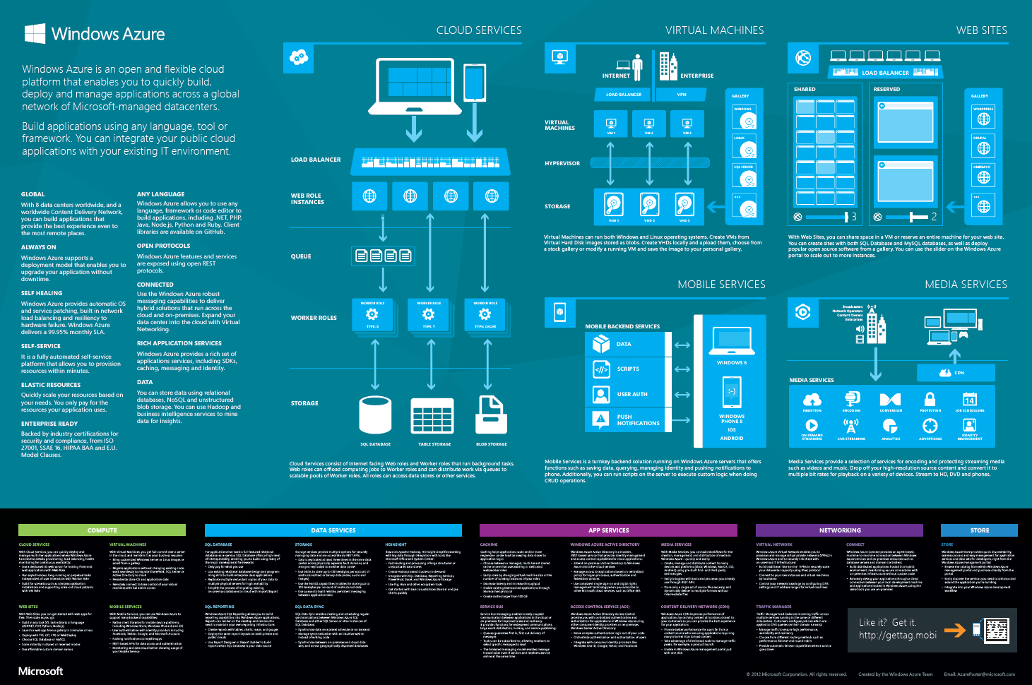
Windows Azure
Notes:
Discuss cloud providers such as Amazon EC2.
Ask students if they are using either a public cloud or a private cloud in their organization. If they are, ask them what led them to this decision. Point out to students that they can sign up for a 30-day trial of Windows Azure by going to http://www.windowsazure.com.
20410D
13: Implementing Server Virtualization with Hyper-V

Slide 3
Types de virtualisation
Desktop virtualization inclut les technologies suivantes :
Hyper-V (local)
VDI (Virtual Desktop Infrastructure)
Différence entre Desktop Virtualization et Presentation Virtualization :
Desktop Virtualization : une machine virtuelle (OS) par utilisateur
Presentation Virtualization : une machine virtuelle (OS) pour plusieurs utilisateurs
Notes:
Discuss the use of desktop virtualization and the differences between Virtual PC on Windows® 7 and Client Hyper‑V on Windows 8 and Windows 8.1
Virtual PC can run only x86 virtual machines.
Client Hyper‑V supports almost all features available in Hyper‑V on Windows Server 2012.
Discuss why administrators might want to run demonstration labs on Windows 8 or Windows 8.1 clients, rather than deploying them on production servers.
This method allows a less formal proof-of-concept phase before dedicating organizational resources to a test.
20410D
13: Implementing Server Virtualization with Hyper-V

Slide 4
Virtual Machine Hardware
Matériel simulé par défaut :
BIOS
Memory
Processor
IDE Controller 0 and 1
SCSI Controller
Synthetic Network Adapter
COM 1 and 2
Diskette Drive
Matériel pouvant être ajouté :
SCSI Controller (up to 4)
Network Adapter
Legacy Network Adapter
Fibre Channel adapter
RemoteFX 3D video adapter
Notes:
When presenting this slide, explain the different hardware components that virtual machines can include. Additionally, explain the limitations of Integrated Drive Electronics (IDE) and SCSI devices.
20410D
13: Implementing Server Virtualization with Hyper-V

Slide 5
Generation 2 Virtual Machines
Génération 1 : Fournit le même matériel virtuel à la machine virtuelle que dans les versions précédentes d'Hyper-V
Génération 2 : Apporte de nouvelles fonctionnalités
PXE boot
Boot à partir d’un disque dur virtuel SCSI
Boot à partir d’un lecteur DVD virtuel SCSI
Secure Boot (démarrage signé avec une clé chiffrée)
Support du UEFI firmware
Notes:
Introduce the generation 2 virtual machine. Point out that virtual machines that were used before Windows Server 2012 R2 are all generation 1, and that generation 2 virtual machines are available only with Hyper-V on Windows Server 2012 R2. Explain that unlike with generation 1 virtual machines, emulated hardware components are not present in generation 2 virtual machines. Conversely, new features, such as Secure Boot and boot from SCSI controller, are present in generation 2 virtual machines.
Point out that generation 2 virtual machines do not have better performance, except when starting and installing operating systems. Emphasize that you can install only supported operating systems on generation 2 virtual machines, which are:
Windows Server 2012.
64-bit versions of Windows 8 and newer operating systems.
20410D
13: Implementing Server Virtualization with Hyper-V

Slide 6
Virtual Machine Integration Services
Les services d'intégration comprennent:
Arrêt du système d'exploitation
Synchronisation de l'heure
L'échange de données
Sauvegarde (instantanés)
Le mode de session amélioré permet une connexion à une machine virtuelle similaire à celle du bureau à distance car elle:
Permet la redirection de périphérique
Utilise un presse-papiers partagé
Permet la redirection de dossiers
Notes:
The parameters on the slide are listed in the virtual machine’s Settings dialog box. This dialog box is accessible by right-clicking on a virtual machine, and then clicking Settings.
Describe each virtual machine integration services component.
Describe the supported operating systems.
Mention that it is not necessary to install virtual machine components, but that it does make managing virtual machines substantially easier.
20410D
13: Implementing Server Virtualization with Hyper-V

Slide 7

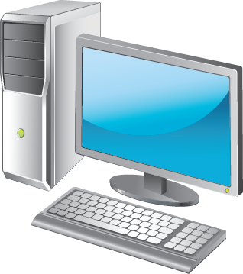

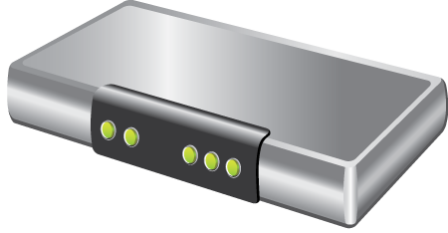
Virtual Switch Extensions
Permet aux fournisseurs tiers de créer des switches virtuels pouvant être ajoutés à Hyper-V.
Ils se configurent comme les switches physiques et apportent les fonctionnalités suivantes : surveillance, filtrage et tranfert de paquets
Virtual switches
Physical switches
Notes:
Several networking vendors have already used Hyper-V virtual switch extensions extensibility to implement virtual versions of hardware switches. Prior to teaching this course, you may want to investigate vendors that have produced virtual versions of hardware switches, and then ask the students if they use any of this equipment in their own organizational environments.
20410D
13: Implementing Server Virtualization with Hyper-V

Slide 8
NIC Teaming?
Renforce la redondance et libère de la bande passante
Est pris en charge par les hôtes, ainsi que par les machines virtuelles
NIC Teaming et les machines virtuelles :
Nécessite plusieurs cartes réseaux virtuelles
Doit être activé sur un adaptateur réseau virtuel
Peut-être implémenté dans le système d'exploitation de la machine virtuelle (si pris en charge)
Notes:
Explain why you would want to configure virtual NIC Teaming for virtual machines. Discuss how you can use multiple NIC Teams on the host connected to multiple virtual switches, and then use NIC Teaming that you configure through the virtual machine’s host operating system, to add another layer of performance and redundancy.
20410D
13: Implementing Server Virtualization with Hyper-V

Slide 9
Lab: Implementing Server Virtualization with Hyper-V
Exercise 1: Installing the Hyper-V Role onto a Server Exercise 2: Configuring Virtual Networking Exercise 3: Creating and Configuring a Virtual Machine Exercise 4: Using Virtual Machine Checkpoints
Logon Information
Virtual machine 20410D‑LON‑HOST1
User name Administrator
Password Pa$$w0rd
Estimated Time: 70 minutes
Notes:
Before the students begin the lab, read the lab scenario, and display the next slide. Before each exercise, read the scenario associated with the exercise to the class. The scenarios give context to the lab and exercises, and help to facilitate the discussion at the end of the lab. Remind the students to complete the discussion questions after the last lab exercise.
Note: If the labs are hosted rather than being run on classroom machines, you will be able to perform only “Exercise 3: Creating and Configuring a Virtual Machine.” Hyper-V does not support nested virtual machines, so students will be unable to perform exercises 1, 2, and 4.
As part of your preparation to teach this course, you might consider using a screen-recording app to record exercises 1, 2, and 4, while running the labs on your own equipment. You then could show these videos to the class.
Exercise 1: Installing the Hyper-V Role onto a Server
The first step in migrating to a virtualized environment for the branch office is installing the Hyper‑V role on a new Windows Server 2012 server.
Exercise 2: Configuring Virtual Networking
After installing the Hyper‑V role on the new server, you need to configure the virtual network. You need to create a network that connects to the physical network and a private network that you can use only for communication between virtual machines. You will use the private network when you configure the virtual machines for high availability. You also need to configure a specific range of media access control (MAC) addresses for the virtual machines.
Exercise 3: Creating and Configuring a Virtual Machine
You have been asked to deploy two virtual machines to LON‑HOST1. You have copied a sysprepped virtual hard disk file that hosts a Windows Server 2012 installation.
To minimize disk space use at the cost of performance, you are going to create two differencing virtual hard disk files based on the sysprepped virtual hard disk. You then will use these differencing virtual hard disk files as the virtual hard disk files for the new virtual machines.
Exercise 4: Using Virtual Machine Checkpoints
You are in the process of developing a strategy to mitigate the impact of incorrectly applied change requests. As a part of this strategy development, you are testing the speed and functionality of virtual machine checkpoints to roll back to a previously existing stable configuration.
In this exercise, you will deploy Windows Server 2012 in a virtual machine. You then will create a stable configuration for that virtual machine, and create a virtual machine checkpoint. Finally, you will modify the configuration, and roll back to the checkpoint.
20410D
13: Implementing Server Virtualization with Hyper-V

Slide 10
Lab Scenario
Your assignment is to configure the infrastructure service for a new branch office.
To use the server hardware that is available currently at branch offices more effectively, your manager has decided that all branch office servers will run as virtual machines. You must now configure a virtual network and a new virtual machine for these branch offices.
Notes:
20410D
13: Implementing Server Virtualization with Hyper-V

Slide 11
Lab Review
What type of virtual network switch would you create if you want to allow the virtual machine to communicate with the LAN that is connected to the Hyper-V virtualization server? How can you ensure that no single virtual machine uses all of the available bandwidth that the Hyper-V virtualization server provides? What Dynamic Memory configuration task was not possible on previous versions of Hyper-V, but which you can now perform on a virtual machine that is hosted on the Hyper-V role on a Windows Server 2012 server?
Notes:
Lab Review Questions
Question
What type of virtual network switch would you create if you want to allow the virtual machine to communicate with the LAN that is connected to the Hyper‑V virtualization server?
Answer
You would create an external virtual network switch.
Question
How can you ensure that no single virtual machine uses all of the available bandwidth that the Hyper‑V virtualization server provides?
Answer
You would configure maximum and minimum bandwidth settings on virtual network adapters.
Question
What Dynamic Memory configuration task was not possible on previous versions of Hyper‑V, but which you can now perform on a virtual machine that is hosted on the Hyper‑V role on a Windows Server 2012 server?
Answer
You can modify some Dynamic Memory settings while the virtual machine is running on Hyper‑V. You could not do this in previous Hyper-V versions.
20410D
13: Implementing Server Virtualization with Hyper-V

Slide 12
Module Review and Takeaways
Review Questions Best Practices
Common Issues and Troubleshooting Tips Tools
Notes:
Module Review Questions
Point students to the appropriate section in the course, so that they are able to answer the questions that this section presents.
Question
In which situations should you use a fixed memory allocation instead of Dynamic Memory?
Answer
You should use fixed memory allocation when the:
Guest operating system does not support Dynamic Memory.
Management operating system has limited memory resources, and you need to ensure balanced allocation of memory to the operating systems.
Question
In which situations must you use virtual hard disks with the new .vhdx format, instead of virtual hard disks with the old .vhd format?
Answer
You should use virtual hard disks with the new .vhdx format rather than virtual hard disks with the old .vhd format when you need to:
Support virtual hard disks larger than 2 TB. Virtual hard disks with the new .vhdx format can be a maximum of 64 TB, while virtual hard disks with the old .vhd format are limited to 2 TB.
Protect against data corruption that power failures cause. Virtual hard disks with the new .vhdx format are less likely to become corrupt if an unexpected power failure occurs, because of how the file format processes updates.
Deploy a virtual hard disk to a large sector disk.
Question
You want to deploy a Windows Server 2012 Hyper‑V virtual machine’s virtual hard disk on a file share. What operating system must the file server be running to support this configuration?
Answer
You can only deploy virtual hard disks to file shares that support SMB 3.0, and only the Windows Server 2012 operating system supports hosting of SMB 3.0 file shares.
20410D
13: Implementing Server Virtualization with Hyper-V
(More notes on the next slide)

Slide 13
Notes:
Best Practices
When implementing server virtualization with Hyper‑V, use the following best practices:
Ensure that the processor on the computer that will run Hyper‑V supports hardware assisted virtualization.
Ensure that you provision a virtualization server with adequate RAM. Having multiple virtual machines paging the hard disk drive because they have inadequate memory decreases performance for all virtual machines on the server.
Monitor virtual machine performance carefully. A virtual machine that uses a disproportionate amount of server resources can reduce the performance of all other virtual machines that the same virtualization server is hosting.
Common Issues and Troubleshooting Tips
Common Issue: Cannot deploy Hyper‑V on an x64 platform.
Troubleshooting Tip: Check if the processor supports hardware-assisted virtualization.
Common Issue: Virtual machine does not use Dynamic Memory.
Troubleshooting Tip: The operating system may not support Dynamic Memory. In some non‑Microsoft operating systems, applying a service pack or installing virtual machine integration services resolves this issue.
Tools
You can use the following tools with Hyper‑V to deploy and manage virtual machines.
20410D
13: Implementing Server Virtualization with Hyper-V

Slide 14
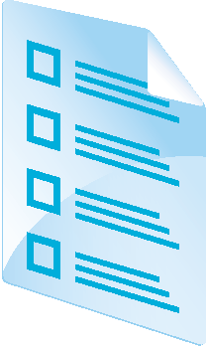

Course Evaluation
Notes:
Remind students to complete the course evaluation.

